Slide 1
Jails
The Drusilla of Institutional Corrections
Do not pass go, do not collect $200

Slide 2
Jail History
The oldest form of institutional corrections
European “goals” as early as 1166 (pronounced jail), precursors much earlier
Overseen by the “shire-reeve”
Fee system
John Howard
Colonial America
Earliest built in 1653 (York Village)
Walnut Street Jail (1773)
Used almost exclusively for pre-trial or pre-sentence detainment

Slide 3
The Drusilla of Institutional Corrections
Perhaps the most “under-studied” component of corrections
State prisons as the “rock stars” of institutional corrections

Slide 4
Pre-trial quandary
What should we do with people awaiting trial or sentencing?
Balance community need for safety, justice, with rights of those accused of crime
Preventative Detention (U.S. vs. Salerno, 1987)
Pre-trial release
BOND
ROR
Conditional Release

Slide 5
Do people on pre-trial release behave?
2006 study of felony cases from large urban counties
18% rearrested while on pre-trial release
22% fail to appear for trial
Only 6% remained fugitives

Slide 6
Does being in jail have an impact on trial/sentencing outcomes?
YES
Quicker dispositions
Harsher dispositions
More apt to get prison/jail time
Get longer sentences
HOWEVER…

Slide 7
Pre-trial Services
Stems from “Manhattan Bail Project”
How to limit bail/ensure that people will still show up for court
Variation in what “pre-trial services” means
Investigation
Supervision
P.O. sorts of stuff
Calling to remind of court appearances, etc.

Slide 8
Modern Jails
Roughly 3,000
Most small <50 inmates
About 60 “mega-jails”
“Big 4” states hold 1/3 of all jail inmates
60% for Pretrial detainment
Other sorts of folks?
Differences between jails and prisons?

Slide 9
Who is in Jail?
Over 50% racial or ethnic (Hispanic) minorities
Mostly (87%) male
Female numbers increased over past decade
Over 50% report physical/sexual abuse
Gender-specific concerns
Drug/alcohol
½ used illicit drugs in month before confinement
¼ were using when they committed the offense
2/3 used alcohol regularly, many were drunk during offense

Slide 10
Jails as a volatile place
Incoming offenders as less stable
Drug and alcohol, shock of arrest, untreated mental illness…
Turnover much higher
Programming limited (only 6% get drug/alcohol treatment
Less sophisticated classification--limited
Suicides area of concern
Prevention better now (suicides down markedly) but still two times higher than in general population
Younger or older, white, males, violent record, in smaller jails as most likely to commit suicide

Slide 11
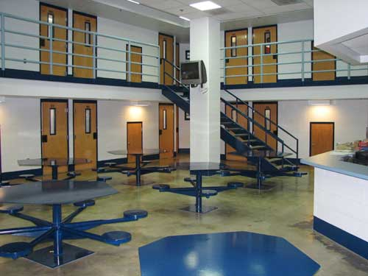
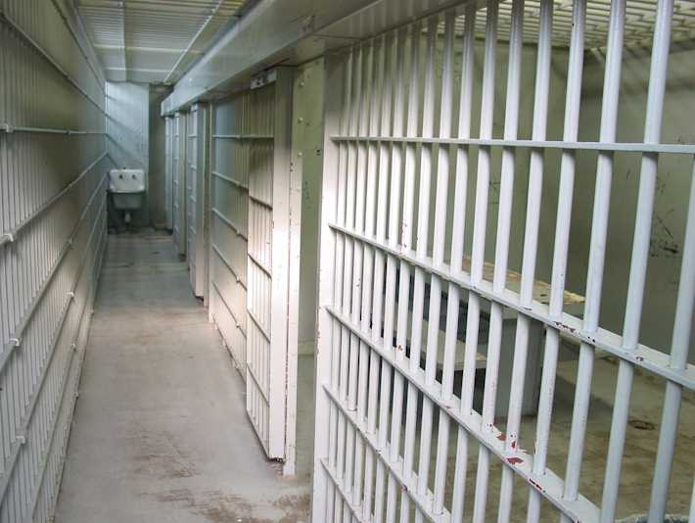
Jail Design

Slide 12
Jail Architecture and Management
Old (first generation) style
Linear facilities
Intermittent supervision
Second generation
Pods + control rooms (indirect supervision)
Third (or “new”) Generation
Pods + direct supervision
Now more about 20% of all facilities—not “new” anymore

Slide 13
Benefits of the New Generation Jails
Cost less to build and maintain
Less opportunity for inmates to engage in nasty stuff, or minor stuff that precedes…
Staff and Inmates more safe
Small groups easier to manage, direct supervision allows “nipping things in the bud,” staff in “control” of the jail
Staff report better job satisfaction, less burnout
All of this ASSSUMES that training and management are adequate—still need research on this

Slide 14
Limits of the New Generation Jail
Increased cost of training
Principles corrupted by crowding
Staff turnover
Small groups become larger
Pods become cluttered with cots, etc.

Slide 15
Jail Crowding
Thing are better now than 1980-1990s, but many are still crowded
Nationally, jails at roughly 90% capacity
750,000 jail inmates, or 250/100,000 as of 2005
In 1995, 500,000 inmates
Factors affecting jail populations
More arrests, more short jail sentences (drugs, problem oriented policing, mandatory arrest)
Prison crowding
5-10% of jail inmates are waiting for space in prison
De-carceration of mentally ill?

Slide 16
Mental Illness and Jail
Mental Illness in jail is 3 times that of general population
64% of jail inmates have mental health problem
BUT – not a great predictor of crime or recidivism
What is going on?
Easier to catch, convict, incarcerate M.D. offenders?
Police → charity arrest, order maintenance
De-institutionalization
Mental illness + homelessness (poverty) + substance abuse = web of entanglement with jails

Slide 17
De-institutionalization in 1970s
Money was supposed to follow the mentally disordered
Jail as “refuge without treatment”
MICHIGAN | Mental Institution Population | Prison Population
1982 | 28,000 | 8,000
2006 | 3,000 | 45,000

Slide 18
Jail Issues in the new millennium
Privatization
CCA, Wackenhut (Now, the GEO Group)
<3% of jail inmates
Regionalization
From 1 county, 1 jail to regional jails
Change in how jails are staffed
Co-equal staffing
Private contracting, separation from Sheriff

